Slide 1

Introduction to UAVCAN/CAN in C (Libcanard)
Github: NXPHovergames/socketcan_canard
Notes:
Hi, my name is Landon Haugh and I am Technical Lead for Marcom University Programs here at NXP. Today I will be giving an introduction to UAVCAN/CAN in C using the Libcanard library. The scope of this presentation is to give viewers a basic understanding of the concept behind UAVCAN. A simple example is written for this presentation and can be found on Github at landonh12/socketcan_canard.

Slide 2
overview
CAN Bus
UAVCAN
Data Structure Description Language (DSDL)
UAVCAN Messages
Libcanard
Libcanard Data Structures
Socketcan_canard repo
Example hierarchy
TX node flow chart
RX node flow chart
Notes:
Alrighty, so for this presentation we will go over some of the basics of a CAN Bus and the UAVCAN protocol. Then we will go over Data Structure Description Language and UAVCAN Messages, as well as the Libcanard library and its data structures needed for basic functionality. Finally, we will show a simple example of Libcanard using the socketcan_canard example project.

Slide 3
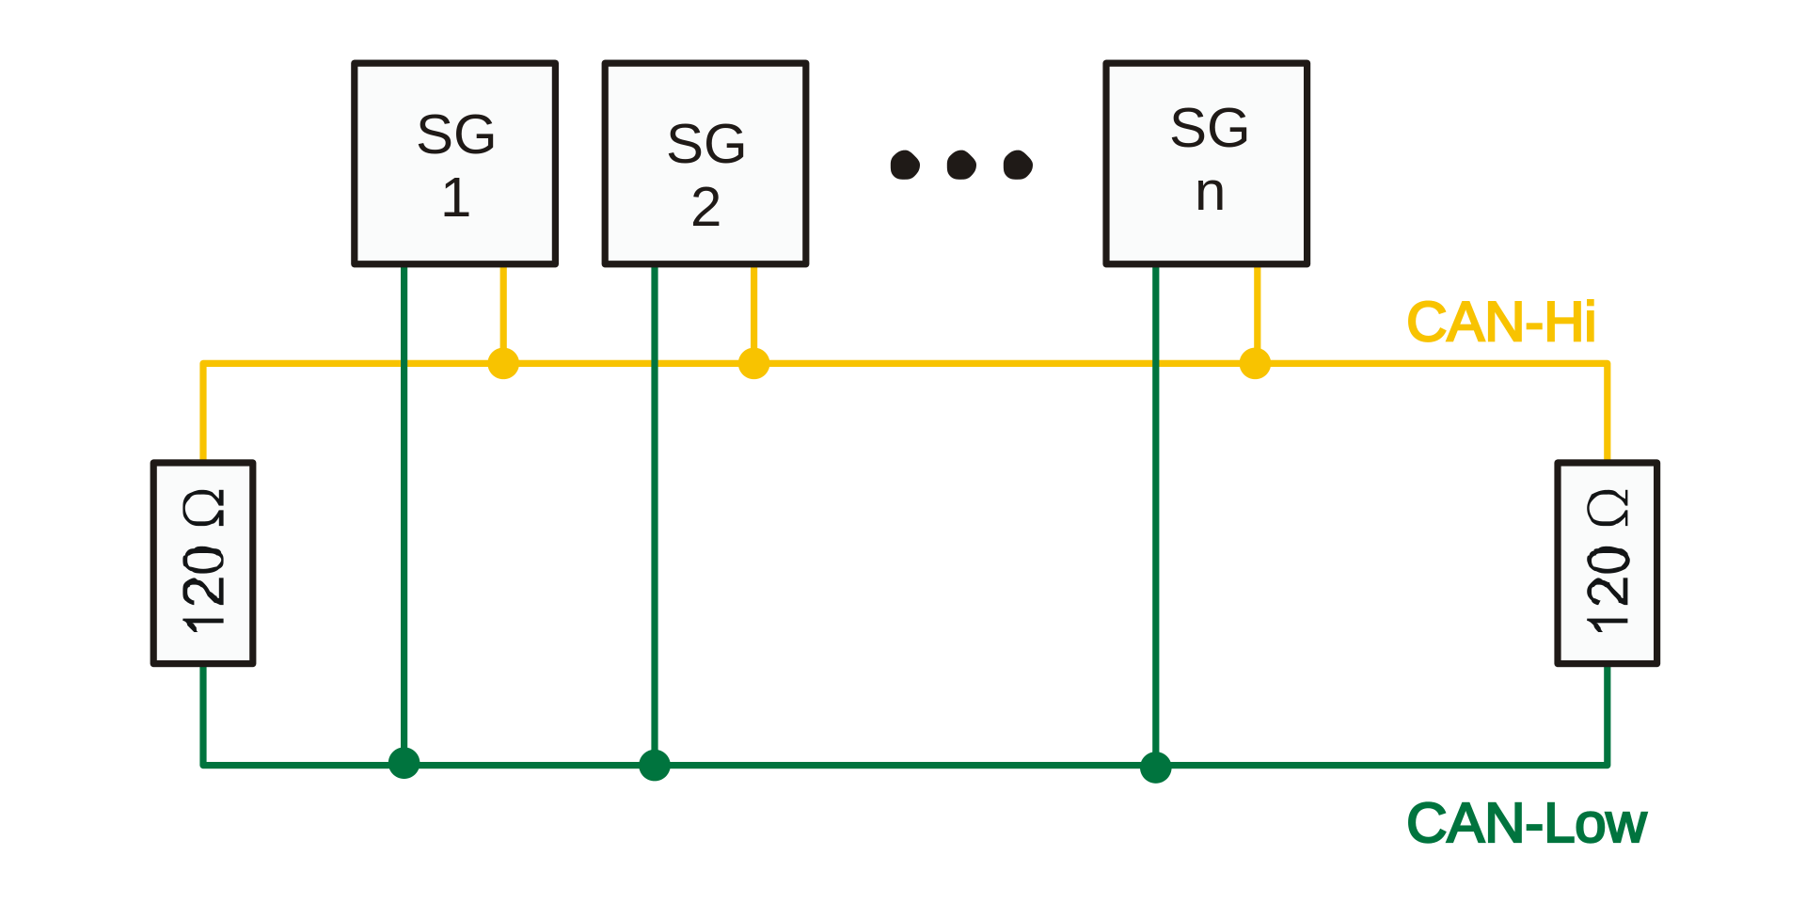
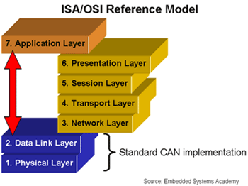
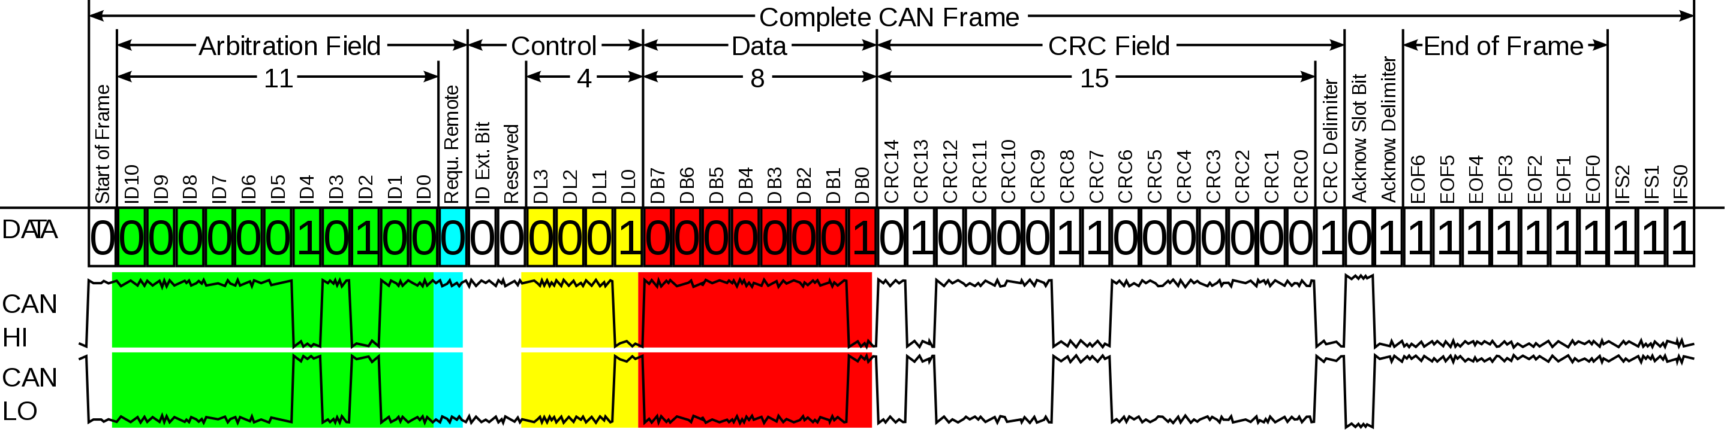
can bus
Robust two-wire interface
Used heavily in the automotive field
CAN frames contain a message ID and data
Data Link layer communicates directly with the Application layer
Data is not in a human readable format
J1939
Source: Wikipedia
Notes:
First, what is a CAN bus?
A CAN bus is a two-wire interface that allows for multiple devices to talk over a distributed network without a host computer. CAN is robust and performs well in noisy environments such as an automobile.
CAN devices communicate using frames of data. These frames consist mostly of a CAN ID and data payload. Each device on the bus sends and receives messages to all other devices, and messages are filtered by their CAN ID. The CAN ID officially acts as a message priority, with lower CAN IDs having higher priority. It also sort of acts as an identifier describing the contents of the data payload so other devices know how to decipher the data.
In CAN, the data link layer communicates directly to the application layer. This means data is not in a human readable format – just 0s and 1s, and this poses a problem for ease-of-use. Several standards exist for implementing a transport and presentation layer for CAN such as J1939, but J1939 is an old, incredibly robust standard meant for things like manufacturing equipment and cars.

Slide 4

uavcan
Decentralized peer network, where each peer (node) has a unique numeric ID.
Publish/subscribe model for various transports such as Ethernet, CAN, etc.
Messages defined and serialized using DSDL (Data Structure Description Language)
Messages are exchanged between nodes and grouped into subjects
Public regulated data types define standardized messages
Notes:
So, enter UAVCAN – a modern, open communication protocol for vehicles such as unmanned aircraft, spacecraft, robots, and more!
UAVCAN stands for Uncomplicated Application-level Vehicular Computing And Networking and is a protocol for a decentralized peer network, where each peer (or node) has a unique numeric ID. There is no host machine, like in CAN, so therefore there is no single point of failure.
UAVCAN uses messages to send and receive data over the various transports such as CAN, Ethernet, Serial, and more. Disclaimer though – CAN is the main theme of this presentation, so we won’t go into specifics on other transports.
Messages are defined and serialized using DSDL (Data structure description language). These messages are grouped into subjects and exchanged between nodes through a publish/subscribe model.
There is a set of public regulated data types (or messages) that are intended for use as a standardized language for UAVCAN nodes. If you’re familiar with ROS, think of it as the ROS common message types, such as geometry_msgs, sensor_msgs, etc.
I included the UAVCAN logo because I think it actually describes UAVCAN quite well. Think of each letter as a node, with the letter being it’s unique identifier (even though IDs are numbers in the spec..). Each node can reach all other nodes and send UAVCAN messages across the distributed network.

Slide 5
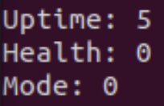

Data structure description language (DSDL)
Message files (.uavcan) are written in DSDL
Nunavut is a tool written in Python for compiling DSDL into C headers
Compiled C header provides functions for serialization/deserialization
Pre-compiled to save processing power at runtime
Compiling DSDL:
1. Install nunavut using Python pip
$ pip3 install nunavut
2. Clone the UAVCAN Public Regulated Data Types
$ git clone https://github.com/uavcan/public_regulated_data_types
3. Compile Standard Fixed ID Data Types
$ nnvg --target-language c --target-endianness little --enable-serialization-asserts public_regulated_data_types/uavcan --lookup public_regulated_data_types/reg
4. Compile Non-standard Fixed ID Data Types (If needed)
$ nnvg --target-language c --target-endianness little --enable-serialization-asserts public_regulated_data_types/reg --lookup public_regulated_data_types/uavcan
Serialize
Deserialize
Notes:
DSDL is the language for UAVCAN messages. DSDL files can either be compiled before runtime for specific programming languages, or compiled at runtime.
Nunavut is a python tool that allows UAVCAN message files to be compiled into C/C++/Python/etc.
When compiled, the headers contain the necessary data structures for each message as well as serialization and deserialization functions. The serialization and deserialization functions are necessary because UAVCAN messages must be serialized into a payload of bits before being sent over the CAN bus.

Slide 6
uavcan message files
Message files are defined similarly to ROS messages
Several messages are regulated (Public regulated data types)
Public regulated data types allow for reusability
Custom messages can be created for specific use cases
Use of public regulated data types is recommended before creating custom messages
Heartbeat_1_0 message (Comments removed)
uint16 MAX_PUBLICATION_PERIOD = 1 # [second]
uint16 OFFLINE_TIMEOUT = 3 # [second]
uint32 uptime # [second]
Health.1.0 health
Mode.1.0 mode
uint8 vendor_specific_status_code
@assert _offset_ % 8 == {0}
@assert _offset_ == {56} # Fits into a single-frame Classic CAN transfer (least capable transport, smallest MTU).
@extent 12 * 8
Notes:
The foundation of UAVCAN falls upon sending and receiving UAVCAN messages. Message files are defined similarly to ROS messages, with each field having a datatype and name.
Custom messages CAN be created for specific use cases, but it is recommended to try and use the public regulated data types before attempting to create a custom message.
As an example, you can see the Heartbeat_1.0 message on the right. This is the only message that is required to be sent by all UAVCAN nodes. The main variables that should be filled out are uptime, health, and mode. You can see that health and mode have a versioned type – that’s because they’re also UAVCAN messages. Nested messages are supported.
The expressions that start with an ampersand describe directives of the message. These directives are described in the UAVCAN specification, and I won’t get into the specifics here, as that is out of the scope of this presentation.

Slide 7
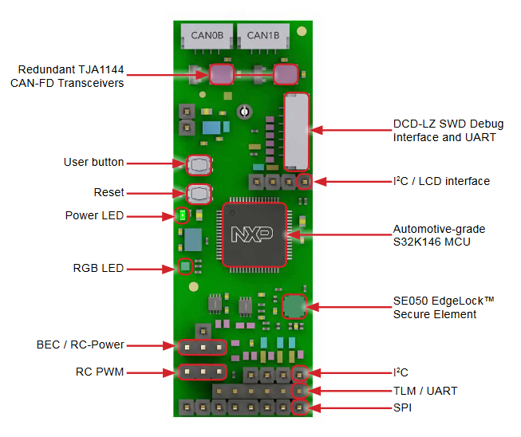
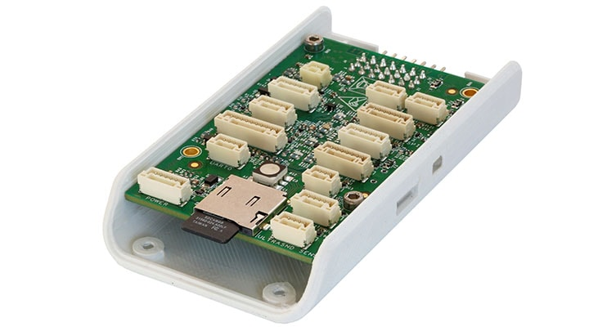
libcanard
Libcanard is a C implementation of the UAVCAN protocol
Low memory footprint (<10KB in this example)
Simple to include in a project – 2 source files and a few headers
UAVCAN
Libcanard
Notes:
UAVCAN is a protocol, for which there is a specification. It is not an implementation. So we need libraries written to implement the spec.
Libcanard is an implementation of the UAVCAN protocol written in C.
It has a low memory footprint, therefore it makes sense for low-resource applications of UAVCAN – in the socketcan_canard example, Libcanard is using less than 10KB of RAM.
Libcanard is simple to include in your projects – just 2 source files and some header files

Slide 8
libcanard data structures
CanardInstance
Node ID
Memory Allocation
RX Subscriptions
TX Queue
CanardTransfer
Timestamp
Priority
Port ID
Data buffer
CanardFrame
Timestamp
CAN ID
Data buffer
CanardRxSubscription
Publish
Subscribe
CanardRxSubscription
CanardTransfer
CanardInstance
CanardFrame
CanardFrame
CanardInstance
CanardTransfer
Notes:
Libcanard implements the UAVCAN protocol using data structures such as CanardInstance, CanardTransfer, and CanardFrame. These three structures are critical for creating a UAVCAN application.
The CanardInstance is a data structure that stores all of the necessary information needed for the UAVCAN protocol to facilitate transfers, subscriptions, and more.
The CanardTransfer is a structure that holds information on a UAVCAN message transfer between nodes.
The CanardFrame holds the CAN ID calculated by the CanardTransfer and the data payload so the user can create a CAN frame for their specific platform. In the socketcan_canard example, we use a Linux SocketCAN frame structure.
CanardRxSubscriptions are used to subscribe to certain UAVCAN messages being sent on the bus. These are not controlled by the application but they play an important role in receiving UAVCAN messages.

Slide 9
CanardInstance (short description)
Field | Description | Possible Values
.user_reference | User pointer that can link the instance with other objects. Just ignore.
.mtu_bytes | Maximum Transmission Unit (MTU). Maximum number of bytes per CAN data frame. (CAN FD or normal CAN?) | Any CAN frame data length >= 8.
.node_id | Node ID of the local node. | 0 to 127 (126 and 127 are reserved for diagnostic and debugging tools, should not be used in fielded systems)
.memory_allocate | Function for o1heap to allocate memory. | Pointer to function o1heapAllocate()
.memory_free | Function for o1heap to free memory. | Pointer to function o1heapFree()
._rx_subscriptions | Array of RX subscriptions. Internal use only, do not access. | -
._tx_queue | TX queue struct. Internal use only, do not access. | -
Notes:
Each UAVCAN node needs to have a CanardInstance created. Just pass a maximum transmission unit (or MTU), Node_ID and functions for memory management.
The Node ID can be from 0 to 127, but 126 and 127 are reserved for debugging and should not be used in a real application.
Memory management is done by the o1heap library. Example functions for o1heap are documented at its Github repo.
CanardInstance also holds fields for subscriptions and a transfer queue – these are controlled by the instance itself, so you shouldn’t mess with these fields as they are private.

Slide 10
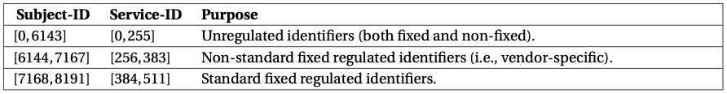
CanardTransfer
Field | Description | Possible values
.timestamp_usec | Timestamp in microseconds. | -
.priority | The priority of the message. | [CanardPriority] Exceptional, Immediate, Fast, High, Nominal, Low, Slow, Optional (4.1.1.3 Spec)
.transfer_kind | The transfer kind of the message. | [CanardTransferKind] Message, Response, Request (4.1.1.4 Spec)
.port_id | Port identifier for the specific message you are sending. | (5.1.1 Spec)
.remote_node_id | Identification number for destination UAVCAN node. | 0 to 127 (126 and 127 are reserved for diagnostic and debugging tools, should not be used in fielded systems) (5.2.1 Spec)
.transfer_id | Commonly referred to as the sequence number in CAN, a number that increments for each transfer | Starts at 0, increments for each transfer. Libcanard takes care of the cyclical aspect, so you don’t have to reset to 0 yourself. (4.1.1.7 Spec)
.payload_size | Size of the payload in bytes. | 0 to 64
.payload | Serialized data to be transferred. | 0 to 64 bytes of data
Notes:
CanardTransfer is a data structure for setting up a UAVCAN message transfer.
It takes a timestamp (transmission deadline for TX, reception time for RX),
a priority and transfer kind,
a port ID (where each UAVCAN message has a specific port ID),
remote node ID for specifying a specific node for transfer (and this is only used for client/server UAVCAN transfers, not publish/subscribe),
a transfer ID which increments once for every message send,
a payload size and payload.

Slide 11
CanardFrame
Field | Description | Possible Values
.timestamp_usec | Timestamp in microseconds. | RX: reception timestamp TX: transmission deadline
.extended_can_id | 29-bit extended CAN ID. Bits above 29 shall be 0. | 0x00000000 to 0x1FFFFFFF
.payload_size | The useful data in the frame. Not to be confused with physical layer CAN DLC. If .payload_size is empty, .payload may be NULL. | 0 to 64
.payload | Pointer to payload. | 0 to 64 bytes of data
Notes:
CanardFrames are generated by pushing a CanardTransfer to the transmission queue. CanardFrames contain CAN specific data such as the timestamp, CAN ID, and payload. In this example, we convert CanardFrames to a SocketCAN frame, but you could convert them into a hardware-specific CAN frame structure if you are writing software for a microcontroller.

Slide 12
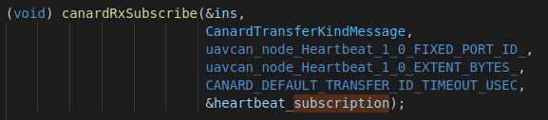
Canardrxsubscription
Field | Description | Possible Values
._transfer_id_timeout_usec | Timeout in microseconds. | Internal use only
._extent | Extent of the message. | Internal use only
._port_id | Port ID of message to be subscribed to | Internal use only
Notes:
CanardRxSubscriptions are used internally and should not be accessed by the application. As a user, you should create a CanardRxSubscription and use the canardRxSubscribe() to tell the CanardInstance you want to subscribe to a message.
You can see the canardRxSubscribe function below: You supply a transfer kind, port ID, buffer size, and transfer timeout along with the CanardRxSubscription structure that you created. CanardInstance will handle subscriptions from there.

Slide 13
High Level Overview (for socketcan_canard example)
Application
DSDL (Nunavut)
Presentation Layer
UAVCAN (Libcanard)
Transport Layer
SocketCAN
CAN Driver
TX Node
RX Node
CAN Hardware
Heartbeat_1_0
Notes:
Here is an overview of where Libcanard fits in the scope of the socketcan_canard example. UAVCAN sits between the application and CAN specific layers.
On the right you can see a simple diagram of the socketcan_canard example setup. We have two UAVCAN nodes running. One of them is mainly for publishing a Heartbeat_1.0 message, and the other is for subscribing to that message. They both sit on a virtual SocketCAN bus.

Slide 14
Create Heartbeat_1_0 message, serialize and place in buffer, create CanardTransfer and push it onto the transmission queue within CanardInstance
UAVCAN/CAN Simple Implementation (TX)
Key:
Datatype Variable_Name
.field1 = ?
.field2 = ?
.field3 = ?
function_name(
type var1,
type2 *var2,
type3 &var3)
Create Heartbeat serialization buffer
Create Heartbeat Message (struct) with Uptime, Health, and Mode
: Instantiated empty, or populated by function
Create Heartbeat serialization buffer size
Comment
Instance
TX Process Function
Serialize Heartbeat Message
Create CanardInstance with Node ID and MTU
Pop sent frame off transmission queue
Transmission Queue
Create CanardTransfer and populate with serialized Heartbeat message, timestamp, transfer ID, payload buffer size, & payload
CanardFrame
.payload_size = hbeat_ser_buf_size
.extended_can_id = ?
.payload = hbeat_ser_buf
CanardFrame
.payload_size = hbeat_ser_buf_size
.extended_can_id = ?
.payload = hbeat_ser_buf
CanardFrame
.payload_size = hbeat_ser_buf_size
.extended_can_id = ?
.payload = hbeat_ser_buf
Raw CAN frame to be sent with SocketCAN
CAN Bus
CanardFrame containing CAN ID, data, size
Peek into transmission queue, copy CanardFrame data to can_frame struct, and send it using SocketCAN. Make sure to pop the frame off the queue!
Push CanardTransfer on transmission queue
Notes:
Here is a flow diagram of a simple TX example

Slide 15
Create Heartbeat_1_0 message, serialize and place in buffer, create CanardTransfer and push it onto the transmission queue within CanardInstance
UAVCAN/CAN Simple Implementation (TX)
Key:
Datatype Variable_Name
.field1 = ?
.field2 = ?
.field3 = ?
function_name(
type var1,
type2 *var2,
type3 &var3)
Create Heartbeat serialization buffer
Create Heartbeat Message (struct) with Uptime, Health, and Mode
: Instantiated empty, or populated by function
Create Heartbeat serialization buffer size
Comment
Instance
TX Process Function
Serialize Heartbeat Message
Create CanardInstance with Node ID and MTU
Pop sent frame off transmission queue
Transmission Queue
Create CanardTransfer and populate with serialized Heartbeat message, timestamp, transfer ID, payload buffer size, & payload
CanardFrame
.payload_size = hbeat_ser_buf_size
.extended_can_id = ?
.payload = hbeat_ser_buf
CanardFrame
.payload_size = hbeat_ser_buf_size
.extended_can_id = ?
.payload = hbeat_ser_buf
CanardFrame
.payload_size = hbeat_ser_buf_size
.extended_can_id = ?
.payload = hbeat_ser_buf
Raw CAN frame to be sent with SocketCAN
CAN Bus
CanardFrame containing CAN ID, data, size
Peek into transmission queue, copy CanardFrame data to can_frame struct, and send it using SocketCAN. Make sure to pop the frame off the queue!
Push CanardTransfer on transmission queue
Notes:
First, we create a CanardInstance and give it a Node ID and MTU.

Slide 16
Create Heartbeat_1_0 message, serialize and place in buffer, create CanardTransfer and push it onto the transmission queue within CanardInstance
UAVCAN/CAN Simple Implementation (TX)
Key:
Datatype Variable_Name
.field1 = ?
.field2 = ?
.field3 = ?
function_name(
type var1,
type2 *var2,
type3 &var3)
Create Heartbeat serialization buffer
Create Heartbeat Message (struct) with Uptime, Health, and Mode
: Instantiated empty, or populated by function
Create Heartbeat serialization buffer size
Comment
Instance
TX Process Function
Serialize Heartbeat Message
Create CanardInstance with Node ID and MTU
Pop sent frame off transmission queue
Transmission Queue
Create CanardTransfer and populate with serialized Heartbeat message, timestamp, transfer ID, payload buffer size, & payload
CanardFrame
.payload_size = hbeat_ser_buf_size
.extended_can_id = ?
.payload = hbeat_ser_buf
CanardFrame
.payload_size = hbeat_ser_buf_size
.extended_can_id = ?
.payload = hbeat_ser_buf
CanardFrame
.payload_size = hbeat_ser_buf_size
.extended_can_id = ?
.payload = hbeat_ser_buf
Raw CAN frame to be sent with SocketCAN
CAN Bus
CanardFrame containing CAN ID, data, size
Peek into transmission queue, copy CanardFrame data to can_frame struct, and send it using SocketCAN. Make sure to pop the frame off the queue!
Push CanardTransfer on transmission queue
Notes:
Then, we prepare a Heartbeat message for transfer. To prepare the heartbeat message, we first need to create a serialization buffer and buffer size to pass to the Heartbeat_1_0 structure.

Slide 17
Create Heartbeat_1_0 message, serialize and place in buffer, create CanardTransfer and push it onto the transmission queue within CanardInstance
UAVCAN/CAN Simple Implementation (TX)
Key:
Datatype Variable_Name
.field1 = ?
.field2 = ?
.field3 = ?
function_name(
type var1,
type2 *var2,
type3 &var3)
Create Heartbeat serialization buffer
Create Heartbeat Message (struct) with Uptime, Health, and Mode
: Instantiated empty, or populated by function
Create Heartbeat serialization buffer size
Comment
Instance
TX Process Function
Serialize Heartbeat Message
Create CanardInstance with Node ID and MTU
Pop sent frame off transmission queue
Transmission Queue
Create CanardTransfer and populate with serialized Heartbeat message, timestamp, transfer ID, payload buffer size, & payload
CanardFrame
.payload_size = hbeat_ser_buf_size
.extended_can_id = ?
.payload = hbeat_ser_buf
CanardFrame
.payload_size = hbeat_ser_buf_size
.extended_can_id = ?
.payload = hbeat_ser_buf
CanardFrame
.payload_size = hbeat_ser_buf_size
.extended_can_id = ?
.payload = hbeat_ser_buf
Raw CAN frame to be sent with SocketCAN
CAN Bus
CanardFrame containing CAN ID, data, size
Peek into transmission queue, copy CanardFrame data to can_frame struct, and send it using SocketCAN. Make sure to pop the frame off the queue!
Push CanardTransfer on transmission queue
Notes:
Then we create a Heartbeat_1_0 datatype and populate it with Uptime, Health, and Mode values and serialize it using the included serialization function provided through the compiled DSDL header.

Slide 18
Create Heartbeat_1_0 message, serialize and place in buffer, create CanardTransfer and push it onto the transmission queue within CanardInstance
UAVCAN/CAN Simple Implementation (TX)
Key:
Datatype Variable_Name
.field1 = ?
.field2 = ?
.field3 = ?
function_name(
type var1,
type2 *var2,
type3 &var3)
Create Heartbeat serialization buffer
Create Heartbeat Message (struct) with Uptime, Health, and Mode
: Instantiated empty, or populated by function
Create Heartbeat serialization buffer size
Comment
Instance
TX Process Function
Serialize Heartbeat Message
Create CanardInstance with Node ID and MTU
Pop sent frame off transmission queue
Transmission Queue
Create CanardTransfer and populate with serialized Heartbeat message, timestamp, transfer ID, payload buffer size, & payload
CanardFrame
.payload_size = hbeat_ser_buf_size
.extended_can_id = ?
.payload = hbeat_ser_buf
CanardFrame
.payload_size = hbeat_ser_buf_size
.extended_can_id = ?
.payload = hbeat_ser_buf
CanardFrame
.payload_size = hbeat_ser_buf_size
.extended_can_id = ?
.payload = hbeat_ser_buf
Raw CAN frame to be sent with SocketCAN
CAN Bus
CanardFrame containing CAN ID, data, size
Peek into transmission queue, copy CanardFrame data to can_frame struct, and send it using SocketCAN. Make sure to pop the frame off the queue!
Push CanardTransfer on transmission queue
Notes:
Once the payload is serialized and stored in a buffer, we create a CanardTransfer and populate it with the necessary data such as timestamp, transfer ID, payload buffer size and pointer to the payload buffer. We then push this CanardTransfer on to the Transmission Queue to be processed by our background thread.

Slide 19
Create Heartbeat_1_0 message, serialize and place in buffer, create CanardTransfer and push it onto the transmission queue within CanardInstance
UAVCAN/CAN Simple Implementation (TX)
Key:
Datatype Variable_Name
.field1 = ?
.field2 = ?
.field3 = ?
function_name(
type var1,
type2 *var2,
type3 &var3)
Create Heartbeat serialization buffer
Create Heartbeat Message (struct) with Uptime, Health, and Mode
: Instantiated empty, or populated by function
Create Heartbeat serialization buffer size
Comment
Instance
TX Process Function
Serialize Heartbeat Message
Create CanardInstance with Node ID and MTU
Pop sent frame off transmission queue
Transmission Queue
Create CanardTransfer and populate with serialized Heartbeat message, timestamp, transfer ID, payload buffer size, & payload
CanardFrame
.payload_size = hbeat_ser_buf_size
.extended_can_id = ?
.payload = hbeat_ser_buf
CanardFrame
.payload_size = hbeat_ser_buf_size
.extended_can_id = ?
.payload = hbeat_ser_buf
CanardFrame
.payload_size = hbeat_ser_buf_size
.extended_can_id = ?
.payload = hbeat_ser_buf
Raw CAN frame to be sent with SocketCAN
CAN Bus
CanardFrame containing CAN ID, data, size
Peek into transmission queue, copy CanardFrame data to can_frame struct, and send it using SocketCAN. Make sure to pop the frame off the queue!
Push CanardTransfer on transmission queue
Notes:
Once we push a CanardTransfer to the transmission queue, we then run our TX process function to facilitate transfer of CanardFrames in the queue. If the current time is not past the CanardFrame’s transmission deadline, it will be unpacked into a SocketCAN frame and sent over the CAN bus. Once it is sent, the frame will be popped off the transmission queue and have its memory freed.

Slide 20
Create Heartbeat_1_0 message, serialize and place in buffer, create CanardTransfer and push it onto the transmission queue within CanardInstance
UAVCAN/CAN Simple Implementation (TX)
Key:
Datatype Variable_Name
.field1 = ?
.field2 = ?
.field3 = ?
function_name(
type var1,
type2 *var2,
type3 &var3)
size_t hbeat_ser_buf_size =
uavcan_node_Heartbeat_1_0_EXTENT_BYTES_
uavcan_node_Heartbeat_1_0 test_heartbeat
.uptime = uptimeSec
.health = uavcan_node_Health_1_0_NOMINAL
.mode = uavcan_node_Mode_1_0_OPERATIONAL
: Instantiated empty, or populated by function
uint8_t hbeat_ser_buf[
uavcan_node_Heartbeat_1_0_EXTENT_BYTES_]
Comment
Instance
TX Process Thread
uavcan_node_Heartbeat_1_0_serialize_(
&test_heartbeat,
hbeat_ser_buf,
&hbeat_ser_buf_size
CanardInstance ins
.mtu_bytes = CANARD_MTU_CAN_FD
.node_id = 96
Transmission Queue
canardTxPop(
(CanardInstance* const)&ins)
CanardTransfer transfer
.timestamp_usec = time()
.priority = CanardPriorityNominal
.transfer_kind = CanardTransferKindMessage
.port_id = uavcan_node_Heartbeat_1_0_FIXED_PORT_ID
.remote_node_id = CANARD_NODE_ID_UNSET
.transfer_id = my_message_transfer_id
.payload_size = hbeat_ser_buf_size
.payload = hbeat_ser_buf
CanardFrame
.payload_size = hbeat_ser_buf_size
.extended_can_id = ?
.payload = hbeat_ser_buf
CanardFrame
.payload_size = hbeat_ser_buf_size
.extended_can_id = ?
.payload = hbeat_ser_buf
struct can_frame frame
.can_dlc = CanardFrame.payload_size
.can_id = CanardFrame.extended_can_id
.data = CanardFrame.payload
CanardFrame
.payload_size = hbeat_ser_buf_size
.extended_can_id = ?
.payload = hbeat_ser_buf
CAN Bus
CanardFrame
.payload_size = hbeat_ser_buf_size
.extended_can_id = ?
.payload = hbeat_ser_buf
Peek into transmission queue, copy CanardFrame data to can_frame struct, and send it using SocketCAN. Make sure to pop the frame off the queue!
canardTxPush(
(CanardInstance* const)&ins,
&transfer)
Notes:
Here is the same flow diagram of the TX node, but with more details showing each field of our data structures.

Slide 21
UAVCAN/CAN Simple Implementation (RX)
Key:
Receive CAN frame and translate to CanardFrame
Datatype Variable_Name
.field1 = ?
.field2 = ?
.field3 = ?
function_name(
type var1,
type2 *var2,
type3 &var3)
Subscribe to Fixed Port ID 7509 (Hearbeat_1_0)
CAN Bus
Create Heartbeat subscription
: Instantiated empty, or populated by function
Comment
Instance
Ask CanardInstance to subscribe to Heartbeat messages
Receive raw CAN frame with data
Create Heartbeat data structure, print data
Create CanardFrame and populate fields with raw CAN data
Create CanardInstance
Ask CanardInstance to accept incoming frame
Create empty CanardTransfer, use canardAccept to populate
Deserialize Heartbeat serialization buffer
Deserialize the transfer and populate Heartbeat_1_0 data struct for application use
Ask CanardInstance to accept incoming frame and populate CanardTransfer
Notes:
This is a flow diagram of the RX node.

Slide 22
UAVCAN/CAN Simple Implementation (RX)
Key:
Receive CAN frame and translate to CanardFrame
Datatype Variable_Name
.field1 = ?
.field2 = ?
.field3 = ?
function_name(
type var1,
type2 *var2,
type3 &var3)
Subscribe to Fixed Port ID 7509 (Hearbeat_1_0)
CAN Bus
Create Heartbeat subscription
: Instantiated empty, or populated by function
Comment
Instance
Ask CanardInstance to subscribe to Heartbeat messages
Receive raw CAN frame with data
Create Heartbeat data structure, print data
Create CanardFrame and populate fields with raw CAN data
Create CanardInstance
Ask CanardInstance to accept incoming frame
Create empty CanardTransfer, use canardAccept to populate
Deserialize Heartbeat serialization buffer
Deserialize the transfer and populate Heartbeat_1_0 data struct for application use
Ask CanardInstance to accept incoming frame and populate CanardTransfer
Notes:
Like always, first create your CanardInstance and give it a Node ID as well as MTU..

Slide 23
UAVCAN/CAN Simple Implementation (RX)
Key:
Receive CAN frame and translate to CanardFrame
Datatype Variable_Name
.field1 = ?
.field2 = ?
.field3 = ?
function_name(
type var1,
type2 *var2,
type3 &var3)
Subscribe to Fixed Port ID 7509 (Hearbeat_1_0)
CAN Bus
Create Heartbeat subscription
: Instantiated empty, or populated by function
Comment
Instance
Ask CanardInstance to subscribe to Heartbeat messages
Receive raw CAN frame with data
Create Heartbeat data structure, print data
Create CanardFrame and populate fields with raw CAN data
Create CanardInstance
Ask CanardInstance to accept incoming frame
Create empty CanardTransfer, use canardAccept to populate
Deserialize Heartbeat serialization buffer
Deserialize the transfer and populate Heartbeat_1_0 data struct for application use
Ask CanardInstance to accept incoming frame and populate CanardTransfer
Notes:
Then, create a Heartbeat_1_0 subscription and pass it to the CanardInstance via a subscribe function.

Slide 24
UAVCAN/CAN Simple Implementation (RX)
Key:
Receive CAN frame and translate to CanardFrame
Datatype Variable_Name
.field1 = ?
.field2 = ?
.field3 = ?
function_name(
type var1,
type2 *var2,
type3 &var3)
Subscribe to Fixed Port ID 7509 (Hearbeat_1_0)
CAN Bus
Create Heartbeat subscription
: Instantiated empty, or populated by function
Comment
Instance
Ask CanardInstance to subscribe to Heartbeat messages
Receive raw CAN frame with data
Create Heartbeat data structure, print data
Create CanardFrame and populate fields with raw CAN data
Create CanardInstance
Ask CanardInstance to accept incoming frame
Create empty CanardTransfer, use canardAccept to populate
Deserialize Heartbeat serialization buffer
Deserialize the transfer and populate Heartbeat_1_0 data struct for application use
Ask CanardInstance to accept incoming frame and populate CanardTransfer
Notes:
Then, receive CAN frames from the bus, translate the raw CAN frame to a CanardFrame,

Slide 25
UAVCAN/CAN Simple Implementation (RX)
Key:
Receive CAN frame and translate to CanardFrame
Datatype Variable_Name
.field1 = ?
.field2 = ?
.field3 = ?
function_name(
type var1,
type2 *var2,
type3 &var3)
Subscribe to Fixed Port ID 7509 (Hearbeat_1_0)
CAN Bus
Create Heartbeat subscription
: Instantiated empty, or populated by function
Comment
Instance
Ask CanardInstance to subscribe to Heartbeat messages
Receive raw CAN frame with data
Create Heartbeat data structure, print data
Create CanardFrame and populate fields with raw CAN data
Create CanardInstance
Ask CanardInstance to accept incoming frame
Create empty CanardTransfer, use canardAccept to populate
Deserialize Heartbeat serialization buffer
Deserialize the transfer and populate Heartbeat_1_0 data struct for application use
Ask CanardInstance to accept incoming frame and populate CanardTransfer
Notes:
and ask CanardInstance to accept that incoming frame. CanardInstance will check to make sure that it is currently subscribed to that message and that it is one of the intended recipients of that message. If CanardInstance accepts the message, then the accept function will populate a CanardTransfer structure that you fed into the function.

Slide 26
UAVCAN/CAN Simple Implementation (RX)
Key:
Receive CAN frame and translate to CanardFrame
Datatype Variable_Name
.field1 = ?
.field2 = ?
.field3 = ?
function_name(
type var1,
type2 *var2,
type3 &var3)
Subscribe to Fixed Port ID 7509 (Hearbeat_1_0)
CAN Bus
Create Heartbeat subscription
: Instantiated empty, or populated by function
Comment
Instance
Ask CanardInstance to subscribe to Heartbeat messages
Receive raw CAN frame with data
Create Heartbeat data structure, print data
Create CanardFrame and populate fields with raw CAN data
Create CanardInstance
Ask CanardInstance to accept incoming frame
Deserialize Heartbeat serialization buffer
Create empty CanardTransfer, use canardAccept to populate
Deserialize the transfer and populate Heartbeat_1_0 data struct for application use
Ask CanardInstance to accept incoming frame and populate CanardTransfer
Notes:
Once this is done, you can use the Heartbeat_1_0 deserialization function that is included in the C header to retreive the human-readable data.

Slide 27
UAVCAN/CAN Simple Implementation (RX)
Key:
Receive CAN frame and translate to CanardFrame
Datatype Variable_Name
.field1 = ?
.field2 = ?
.field3 = ?
function_name(
type var1,
type2 *var2,
type3 &var3)
Subscribe to Fixed Port ID 7509 (Hearbeat_1_0)
CAN Bus
Create Heartbeat subscription
: Instantiated empty, or populated by function
Comment
Instance
Ask CanardInstance to subscribe to Heartbeat messages
Receive raw CAN frame with data
Create Heartbeat data structure, print data
Create CanardFrame and populate fields with raw CAN data
Create CanardInstance
Ask CanardInstance to accept incoming frame
Deserialize Heartbeat serialization buffer
Create empty CanardTransfer, use canardAccept to populate
Deserialize the transfer and populate Heartbeat_1_0 data struct for application use
Ask CanardInstance to accept incoming frame and populate CanardTransfer
Notes:
From there you can do whatever you want with it, here we just print out the data.

Slide 28
UAVCAN/CAN Simple Implementation (RX)
Key:
Receive CAN frame and translate to CanardFrame
Datatype Variable_Name
.field1 = ?
.field2 = ?
.field3 = ?
function_name(
type var1,
type2 *var2,
type3 &var3)
Subscribe to Fixed Port ID 7509 (Hearbeat_1_0)
CAN Bus
CanardRxSubscription heartbeat_subscription
: Instantiated empty, or populated by function
Comment
Instance
canardRxSubscribe(
&ins,
CanardTransferKindMessage,
uavcan_node_Heartbeat_1_0_FIXED_PORT_ID_,
uavcan_node_Heartbeat_1_0_EXTENT_BYTES_,
CANARD_TRANSFER_ID_TIMEOUT_USEC,
&heartbeat_subscription)
struct can_frame socketcan_frame
.can_id = 0x107D5560
.can_dlc = 8
.data = 03 00 00 00 00 00 00 E3
Heartbeat_1_0 RX_hbeat
.uptime
.health
.mode
CanardFrame received_canard_frame
.payload_size = socketcan_frame.can_dlc
.extended_can_id = socketcan_frame.can_id
.timestamp_usec = time(NULL)
.payload = socketcan_frame.data
CanardInstance ins
.mtu_bytes = CANARD_MTU_CAN_FD
.node_id = 97
canardRxAccept(
CanardInstance &ins,
CanardFrame &received_canard_frame,
0,
&transfer)
uavcan_node_Heartbeat_1_0_deserialize(
&RX_hbeat,
transfer.payload,
&hbeat_ser_buf_size)
CanardTransfer transfer
Deserialize the transfer and populate Heartbeat_1_0 data struct for application use
Ask CanardInstance to accept incoming frame and populate CanardTransfer
Notes:
Here is a more detailed view of the RX node, showing the fields for each data structure.

Slide 29
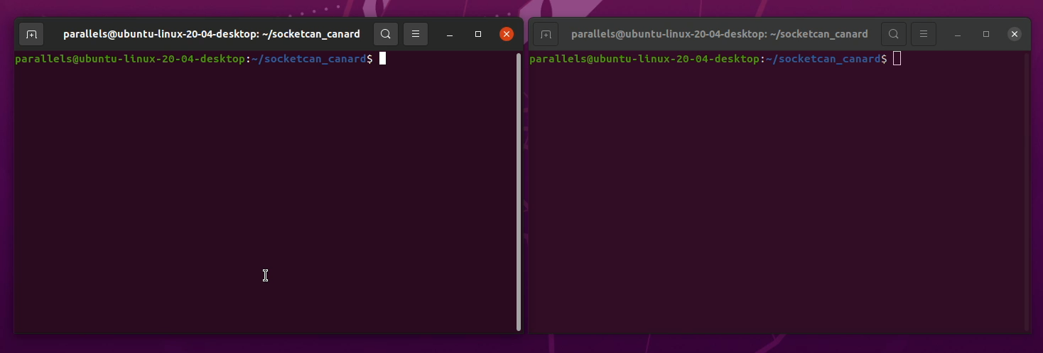
socketcan_canard demo
Notes:
Here you can see a demo of the socketcan canard application. First, we build the project using the included makefile. Then, we run the RX node in one terminal and the TX node in the other. The TX node will create a heartbeat message with the necessary data such as uptime, health, and mode. Then the TX node will create a CanardTransfer after serializing the heartbeat message and push that to the transmission queue. Then the CanardFrame data will be printed to the console and get sent over the CAN bus. You can see the CAN ID and data payload being sent. In the RX node, the socketcan frame will be received and unpacked into a CanardFrame. The data in the CanardFrame is then deserialized and printed to the console.

Slide 30
uavcan in the field (rover)
Key
UAVCAN Node
Peripheral
LEDs
CAN Transciever
BLDC Motor
BLDC Motor
ToF Sensor
PX4 Compatible GPS Module
Servo
Teensy 3.2
NXP FMUK66
ESC
ESC
Companion Computer (NavQ+)
UCANS32K
UCANS32K
CAN Transciever
Notes:
So you may be wondering what a UAVCAN network looks like in the field. Here is a draft of a UAVCAN network using NXP components on a robot such as a Rover.
The first thing to mention is that all nodes will be sending heartbeat messages.
The FMUK66 will control BLDC motors through ESCs by sending UAVCAN messages specifying a voltage, current, or other value.
The companion computer can use a time of flight sensor to detect objects and send messages to the FMU for obstacle avoidance.
Two UCANS32K’s can be used as UAVCAN nodes for different peripherals. One can be sending GNSS data from a HolyBro GPS while another can be receiving messages to control a servo.
The Teensy 3.2 will act as an LED controller, receiving status messages from the FMU or the Companion Computer to display colors based on the vehicle’s state.

Slide 31
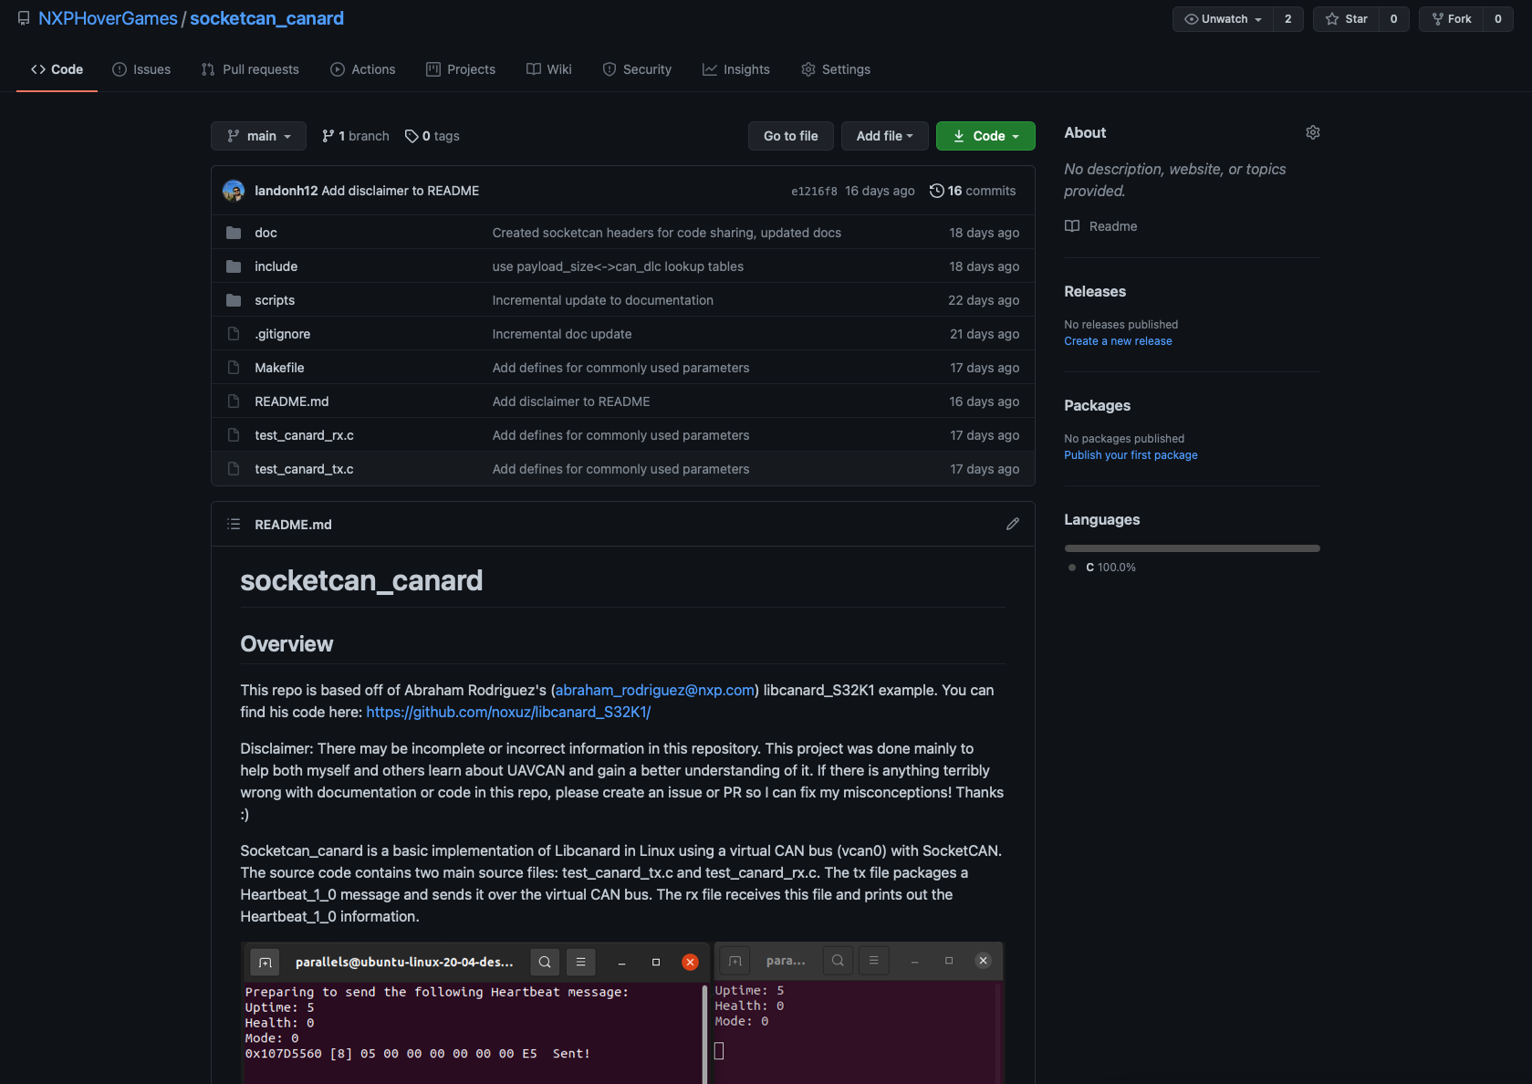
Closing thoughts
Check out the UAVCAN guide and specification by going to https://uavcan.org/
Consider using UAVCAN in your projects
Read through the code in the socketcan_canard repository (https://github.com/NXPHovergames/socketcan_canard)

